Slide 1
HARMFUL GASSES AND AIR POLLUTION

Slide 2
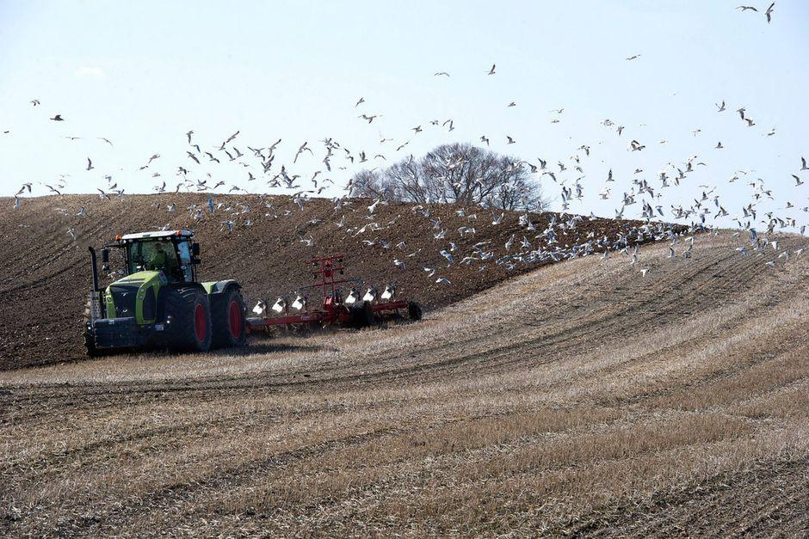
According to the WHO, air pollution is today the most important environmental burden globally .
Pollution gives rise to:
Health effects worldwide - including in Denmark
Reduction of biodiversity
Loss of agricultural production
Climate change

Slide 3
What is the reason for the air pollution in the cities?

Slide 4
Motor-power in the cities
Air pollution is caused by several things, but air pollution from:
cars,
train operations and especially diesel cars bear a large part of the blame. They emit a large amount of NO2 which is dangerous to inhale

Slide 5
Stoves and boilers are the biggest source of particulate and air pollution from our homes. Half of the Danish release of particles originates from firing with firewood in fireplaces.

Slide 6
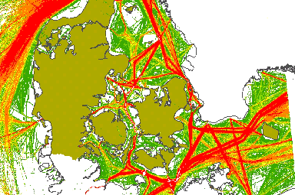
Shipping International shipping from Danish harbors contributes 2.6 million tonnes of CO2, which is not included in Denmark's overall national climate account. This corresponds to an additional emission of 5%. International shipping also contributes to significant emissions of NOx and sulfur dioxide, which correspond to, respectively, 34% and 167% of the quantities in Denmark's national inventory.

Slide 7
Agriculture Pollution from agriculture manifests itself, among other things by contributing to the nitrogen deposition in the air when the fields are fertilized. The map shows deposition of nitrogen over Denmark

Slide 8
What’s in the air ?
Different particles
If you measure air pollution by particles, then a relatively small part of the particles will be 'born' as particles (so-called primary particles),
While a very large part originates from pollution that is 'born' as gaseous species and which is transported over large distances (so-called secondary particles).
In Denmark, it is generally far less than half of the particle pollution that is locally formed due to e.g. traffic and fireplaces.

Slide 9
Measures
Particle pollution varies from year to year and is referred to as:
Suspended dust (TSP) According to Denmark, the limit value should be below 150 micrograms/m3
PM10: (small particles)Danish values ​​of PM10 must be below 40 micrograms/m3
PM 2.5: (the finest particles) value 25 micrograms/m3

Slide 10
Smog alert system includes NO₂, SO₂ and O₃
The population in Denmark is informed if the concentration exceeds some values
Concentrations of NO₂ exceeds 400 µ g/m³ or the concentration of SO₂ exceeds 500 µ g/m³.
O₃ exceeds 180 µ g/m³ Emitted a smog alert if the concentration of O₃ exceeds 240 µ g/m³.
In practice, only the value for information for ozone will be exceeded in Denmark.
It happens very rarely (with years).

Slide 11
Sustainability strategy for Aalborg Commune Aalborg Commune’s sustainability plan from 2020 to 2024 which applies to: Energy, water, waste, nature, climate change, organic production, transport and procurement and thereby fulfills the UN's global goals 6, 7, 12, 13, 14 and 15. All parts affect air pollution to a greater or lesser extent

Slide 12
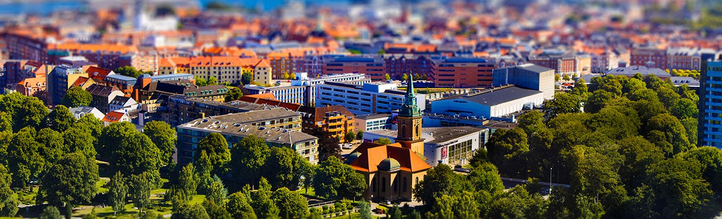
Pollution/Harmful gasses in Aalborg Aalborg commune’s strategy/vision is that the sustainable commune is a safe place: to live, develop businesses and make new investments. Aalborg's DNA must be clear to everyone; in a green balance, in order to ensure that the attractiveness of the commune continues to increase. Aalborg does many things to live up to the DNA of green balance – and pollution is a big issue.

Slide 13
Measuring stations in Aalborg In Aalborg we have four measurings stations and they are all located in the inner city

Slide 14
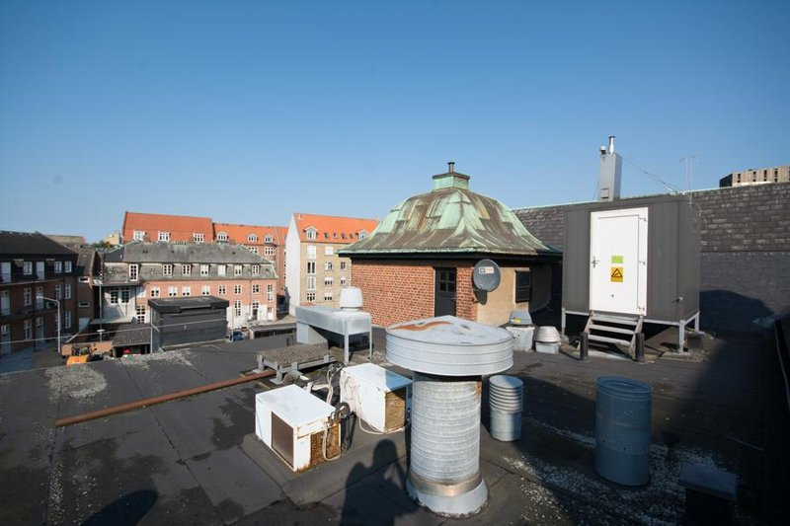
Measure station on Østerbro near by the Cabinn Hotel

Slide 15
Prognosis for Aalborg from the 2nd January to the 5th January

Slide 16
What has Aalborg done - and presentation of what to do, to reduce pollution
The pollution in Aalborg is not critical now for several precautions has been taken:
Decommissioning of cars in inner city – pedestrian streets
All public busses run on CO2 neutral fuel
All chimneys must have a filter
All cars run with new carburetors that trap particles
Calls on the population to quickly switch to electric cars
take public busses for small trips under 10 km
Go several people together in the same car at long distances

Slide 17
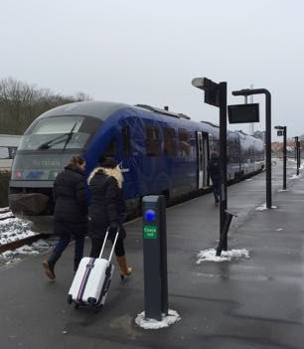
In our region - the first train in Denmark without diesel
At the beginning of February, Nordjyske Jernbaner received the first delivery of a new and
less environmentally harmful liquid fuel for its 21 trains with diesel engines.
Thus, the company, which takes care of the regional train traffic in hole North Jutland,
is the first in Denmark to empty the diesel tanks and then run on a natural gas-based liquid fuel
with less particle emissions and less CO2 discharge

Slide 18
Who has the control in Denmark?
DCE - Danish Centre for Environment and Energy

Slide 19
DCE
Carries out national monitoring of air pollution and atmospheric deposition of pollution in Denmark
The monitoring program has two major objectives
Firstly, air pollution levels are measured in order to control that Denmark comply with the limit values
Secondly, trends are monitored to evaluate whether the national and international initiatives for air pollution regulation are actually working

Slide 20
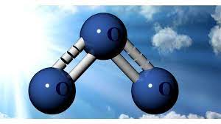
OZON
The European Environment Agency updates ozone data
from the European countries every hour
This data follows the development of ozone episodes at European
Level and can be followed on their website

Slide 21
COVID-19 effect – something to think about…
Model calculations show that air pollution causes about 4,000 premature deaths in Denmark in 2020 and a large number of other negative health effects.
This is about 13% less compared to the reporting for 2019.
This lower number of premature deaths are due to updates in the emission data and changes in emissions due to the COVID-19 restrictions.
Calculations of the entire data series back to 1990 show a decrease in the health effects due to air pollution. In 1990, about 8,200 premature deaths were due to air pollution in Denmark which has decreased with about 51% to around 4,000 premature deaths in 2020.

